Slide 1
Computer Programming Lab 11
2018.05.18

Slide 2
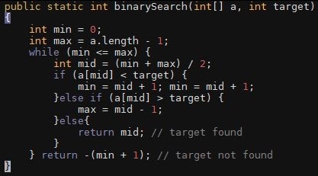
Binary search

Slide 3
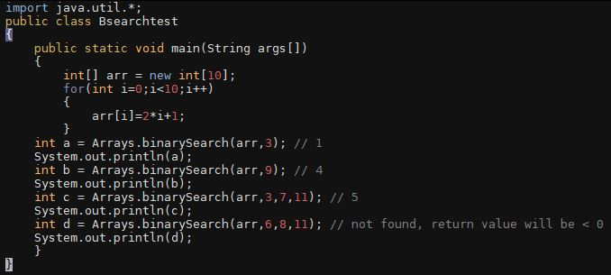
Binary search in java.util

Slide 4
Mergesort procedure

Slide 5
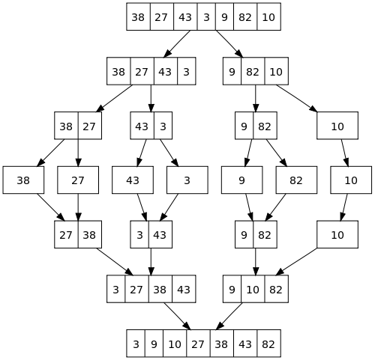
Task
For given numbers, draw mergesort procedure
like right-side picture.
6 1 4 3 5 7 9 2 8 0

Slide 6
Optional task(Linked list + tree)
We call construction of linked list from a tree as ​Preorder construction​. ​Preorder construction​ is as follows:
- Start at the root of the tree
- Traverse the nodes in pre-order and put the key of the node.
- If node has no child, put one more key.
- If node has child, traverse child node first, then put one more key.
Key of tree is always unique. That is, no redundant key exists in the tree.

Slide 7
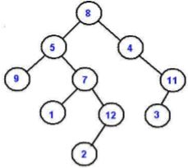
Optional task(Linked list + tree)
For example, the tree in the figure is constructed as linked list 8->5->9->9->7->1->1->12->2->2->12->7->5->4->11->3->3->11->4->8​.
Make two methods, height and depth
public int height() : returns the ​height​ of the current tree. ​
In this example, height is 5
​public int depth(int key) returns the ​level​ of the current tree
depth(1) equals 4, depth(2) equals 5

